Slide 1
For a Synodal Church: Communion, Participation, and Mission
General Secretariat of the Synod of Bishops

Slide 2
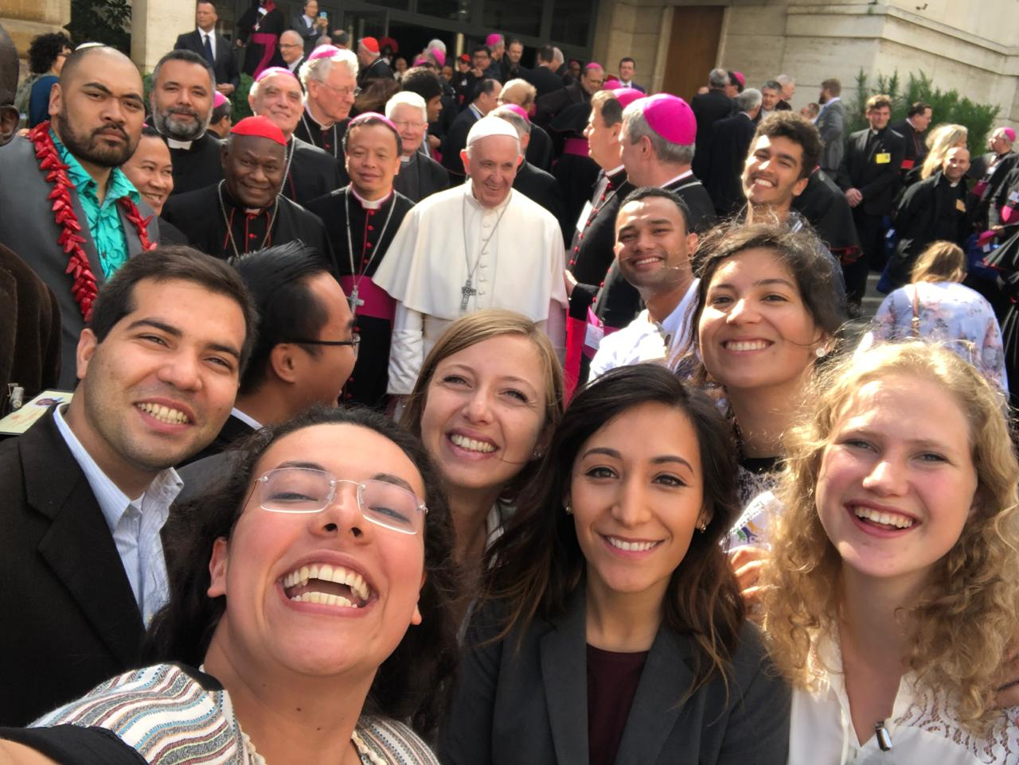
From the Synod on Youth and the Synod on the Amazon to the Synod on Synodality

Slide 3
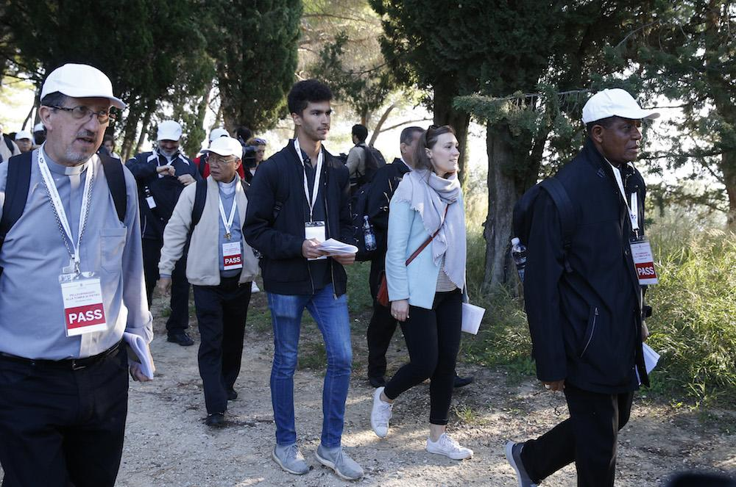
“Synodality is the way of being the Church today according to the will of God, in a dynamic of discerning and listening together to the voice of the Holy Spirit.”
Pope Francis

Slide 4
Together, listening to the Holy Spirit, let us be led by God
We stand before You, Holy Spirit, as we gather together in Your name.
With You alone to guide us, make Yourself at home in our hearts; Teach us the way we must go
and how we are to pursue it.
We are weak and sinful;
do not let us promote disorder. Do not let ignorance
lead us down the wrong path
nor partiality influence our actions.
Let us find in You our unity
so that we may journey together
to eternal life and not stray
from the way of truth and what is right.
All this we ask of You, who are at work in every place and time, in the communion of the Father and the Son, forever and ever. Amen.

Slide 5
The Challenge of Synodality
“What the Lord is asking of us is already in some sense present in the very word “Synod.” Journeying together – laity, pastors, the Bishop of Rome – is an easy concept to put into words, but not so easy to put into practice.”
Pope Francis, Address at the Ceremony Commemorating the 50th Anniversary
of the Institution of the Synod of Bishops,
October 17 2015
Notes:
http://www.vatican.va/content/francesco/en/speeches/2015/october/documents/papa-francesco_20151017_50-anniversario-sinodo.html
We must continue along this path. The world in which we live, and which we are called to love and serve, even with its contradictions, demands that the Church strengthen cooperation in all areas of her mission. It is precisely this path of synodality which God expects of the Church of the third millennium. (Pope Francis, Address at the Commemoration of the 50th Anniversary of the Institution of the Synod of Bishops) * * *
“What the Lord is asking of us is already in some sense present in the very word “Synod.” Journeying together – laity, pastors, the Bishop of Rome – is an easy concept to put into words, but not so easy to put into practice.” (Pope Francis, Address at the Commemoration of the 50th Anniversary of the Institution of the Synod of Bishops)

Slide 6
“The Church of God is convoked in Synod. The path entitled “For a Synodal Church: Communion, Participation, and Mission” will solemnly open on the 9th – 10th of October 2021 in Rome and on the following 17th of October in each particular Church. One fundamental stage will be the celebration of the XVI Ordinary General Assembly of the Synod of Bishops, in October 2023, which will be followed by the implementation phase that will again involve the particular Churches. With this convocation, Pope Francis invites the entire Church to reflect on a theme that is decisive for its life and mission: “It is precisely this path of synodality which God expects of the Church of the third millennium.” This journey, which follows in the wake of the Church’s “renewal” proposed by the Second Vatican Council, is both a gift and a task: by journeying together and reflecting together on the journey that has been made, the Church will be able to learn through Her experience which processes can help her to live communion, to achieve participation, to open herself to mission. Our “journeying together” is, in fact, what most effectively enacts and manifests the nature of the Church as the pilgrim and missionary People of God.”
(PD, 1)
Notes:
The Church of God is convoked in Synod. The path entitled “For a Synodal Church: Communion, Participation, and Mission” will solemnly open on the 9th – 10th of October 2021 in Rome and on the following 17th of October in each particular Church. One fundamental stage will be the celebration of the XVI Ordinary General Assembly of the Synod of Bishops, in October 2023,1 which will be followed by the implementation phase that will again involve the particular Churches (cf. EC, arts. 19-21).
With this convocation, Pope Francis invites the entire Church to reflect on a theme that is decisive for its life and mission: “It is precisely this path of synodality which God expects of the Church of the third millennium.”2 This journey, which follows in the wake of the Church’s “renewal” proposed by the Second Vatican Council, is both a gift and a task: by journeying together and reflecting together on the journey that has been made, the Church will be able to learn through Her experience which processes can help Her to live communion, to achieve participation, to open Herself to mission. Our “journeying together” is, in fact, what most effectively enacts and manifests the nature of the Church as the pilgrim and missionary People of God.

Slide 8
The aim of the Synod
To learn synodality
Reread and Practice
The Synodal conversion of the Church
Putting into practice the Synodal nature of the entire Church

Slide 9
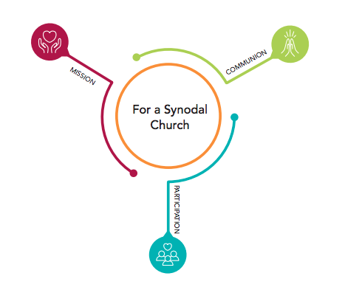
Communion, Participation and Mission
– 3 indispensable keys
at the heart of a Synodal Church

Slide 10
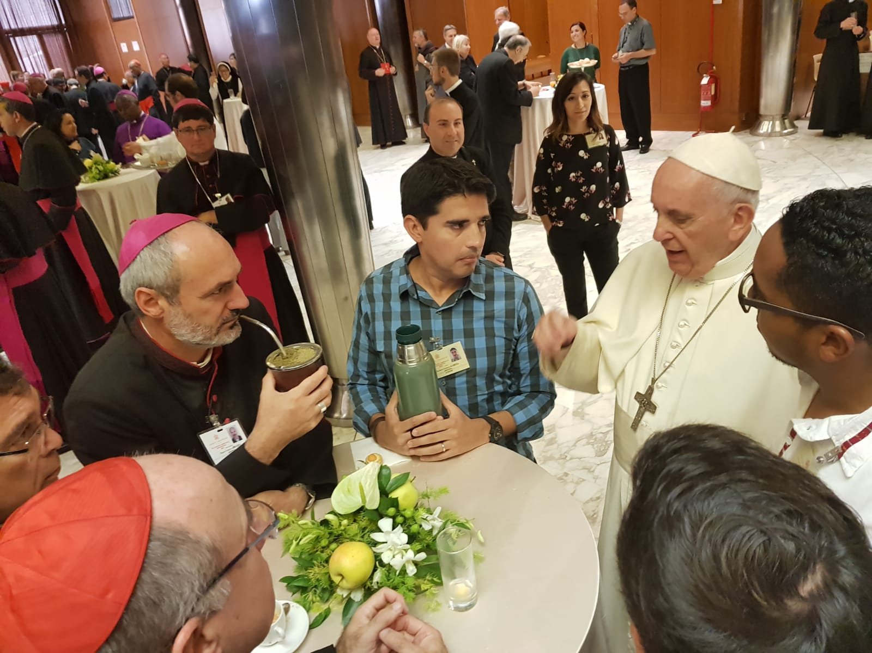

Slide 11
From an event to a process
What’s new in Episcopalis Communio
Article 4: Phases of the Synodal Assembly
Each Synodal Assembly unfolds in a series of phases:
The preparatory phase
The discussion phase (also known as the phase of celebration)
The implementation phase
Notes:
The “discussion phase” is known as the “phase of celebration” in French, Italian, Spanish, Polish, and Portuguese and the “execution phase” in German

Slide 12
Episcopalis Communio emphasizes the local phase
6. The Synod of Bishops must increasingly become a privileged instrument for listening to the People of God.
7. The history of the Church bears ample witness to the importance of consultation for ascertaining the views of the Bishops and the faithful in matters pertaining to the Good of the Church. Hence, even in the preparation of Synodal Assemblies, it is very important that the consultation of all the particular Churches be given special attention.
The synodal process not only has its point of departure but also its point of arrival in the People of God, upon whom the gifts of grace bestowed by the Holy Spirit through the gathering of Bishops in Assembly must be poured out.
Notes:
EPISCOPALIS COMMUNIO, nos. 6-7
“6. Similarly, the Synod of Bishops must increasingly become a privileged instrument for listening to the People of God: “For the Synod Fathers we ask the Holy Spirit first of all for the gift of listening: to listen to God, that with him we may hear the cry of the people; to listen to the people until breathing in the desire to which God calls us”.[23]
“Although structurally it is essentially configured as an episcopal body, this does not mean that the Synod exists separately from the rest of the faithful. On the contrary, it is a suitable instrument to give voice to the entire People of God, specifically via the Bishops, established by God as “authentic guardians, interpreters and witnesses of the faith of the whole Church”,[24] demonstrating, from one Assembly to another, that it is an eloquent expression of synodality as a “constitutive element of the Church”.[25]
“Therefore, as John Paul II declared, “Every General Assembly of the Synod of Bishops is a powerful ecclesial experience, even if some of its practical procedures can always be perfected. The Bishops assembled in Synod represent in the first place their own Churches, but they are also attentive to the contributions of the Episcopal Conferences which selected them and whose views about questions under discussion they then communicate. They thus express the recommendation of the entire hierarchical body of the Church and finally, in a certain sense, the whole Christian people, whose pastors they are”.[26]
“7. The history of the Church bears ample witness to the importance of consultation for ascertaining the views of the Bishops and the faithful in matters pertaining to the good of the Church. Hence, even in the preparation of Synodal Assemblies, it is very important that consultation of all the particular Churches be given special attention. In this initial phase, following the indications of the General Secretariat of the Synod, the Bishops submit the questions to be explored in the Synodal Assembly to the priests, deacons and lay faithful of their Churches, both individually and in associations, without overlooking the valuable contribution that consecrated men and women can offer. Above all, the contribution of the local Church’s participatory bodies, especially the Presbyteral Council and the Pastoral Council, can prove fundamental, and from here “a synodal Church can begin to emerge”.[27]
“During every Synodal Assembly, consultation of the faithful must be followed by discernment on the part of the Bishops chosen for the task, united in the search for a consensus that springs not from worldly logic, but from common obedience to the Spirit of Christ. Attentive to the sensus fidei of the People of God – “which they need to distinguish carefully from the changing currents of public opinion”[28] – the members of the Assembly offer their opinion to the Roman Pontiff so that it can help him in his ministry as universal Pastor of the Church. From this perspective, “the fact that the Synod ordinarily has only a consultative role does not diminish its importance. In the Church the purpose of any collegial body, whether consultative or deliberative, is always the search for truth or the good of the Church. When it is therefore a question involving the faith itself, the consensus ecclesiae is not determined by the tallying of votes, but is the outcome of the working of the Spirit, the soul of the one Church of Christ”.[29] Therefore the vote of the Synod Fathers, “if morally unanimous, has a qualitative ecclesial weight which surpasses the merely formal aspect of the consultative vote”.[30]
“Finally, the Synod Assembly itself must be followed by the implementation phase, so as to initiate the reception of the Synod’s conclusions in all the local Churches, once they have been accepted by the Roman Pontiff in the manner he judges most appropriate. Here it must be remembered that “cultures are in fact quite diverse, and every general principle… needs to be inculturated, if it is to be respected and applied”.[31] In this way, it can be seen that the synodal process not only has its point of departure but also its point of arrival in the People of God, upon whom the gifts of grace bestowed by the Holy Spirit through the gathering of Bishops in Assembly must be poured out.”

Slide 13
Episcopalis Communio emphasizes the local phase
Article 6: Consultation of the People of God
§ 1. The consultation of the People of God takes place in the particular Churches
[…]
In each particular Church, the Bishops carry out the consultation of the People of God by recourse to the participatory bodies provided for by the law, without excluding other methods that they deem appropriate.

Slide 14
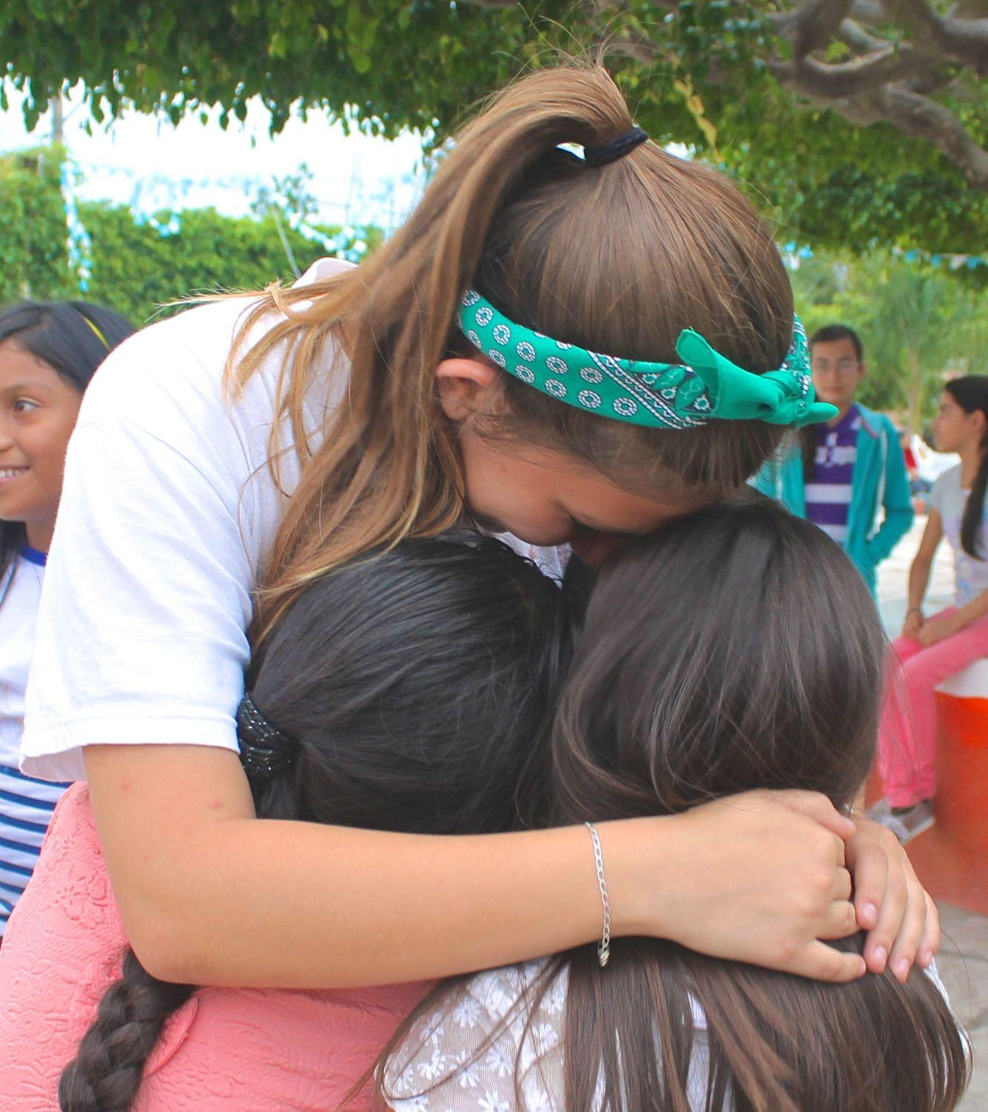
Basic Question of the Synodal Process
A basic question prompts and guides us: How does this “journeying together,” which takes place today on different levels (from the local level to the universal one), allow the Church to proclaim the Gospel in accordance with the mission entrusted to her; and what steps does the Spirit invite us to take in order to grow as a synodal Church?
(PD, 2)
The fundamental question for the consultation of the People of God
A synodal Church, in announcing the Gospel, “journeys together:” How is this “journeying together” happening today in your local Church? What steps does the Spirit invite us to take in order to grow in our “journeying together”?
(PD, 26)

Slide 15
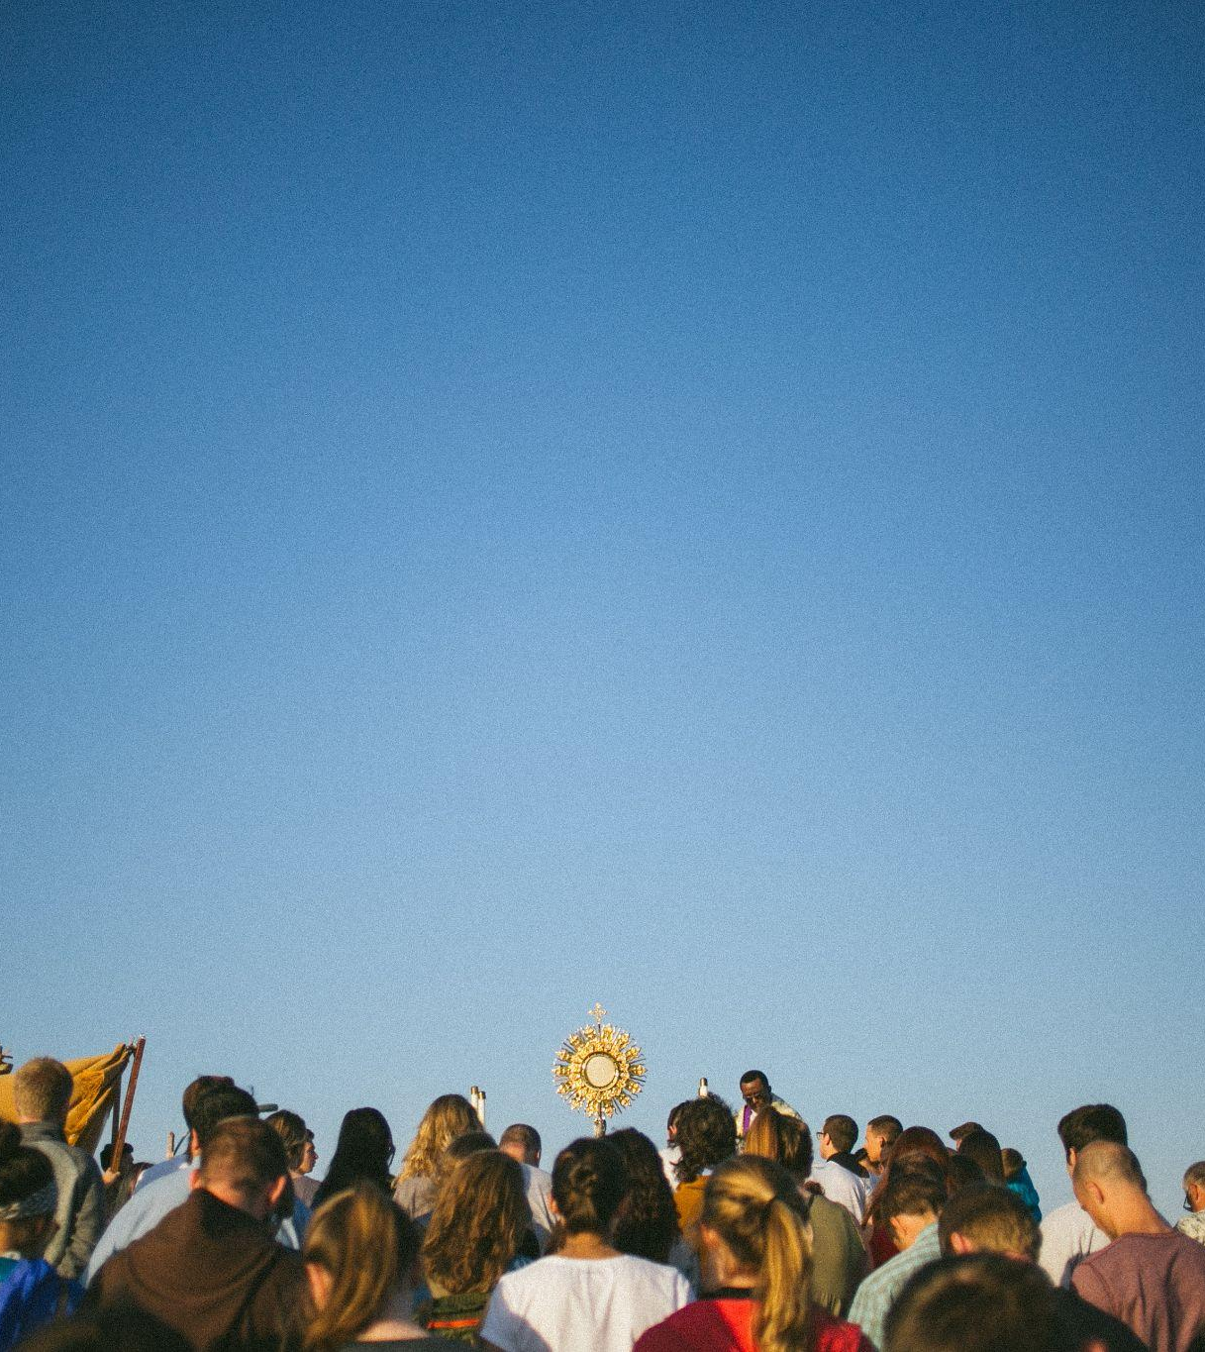
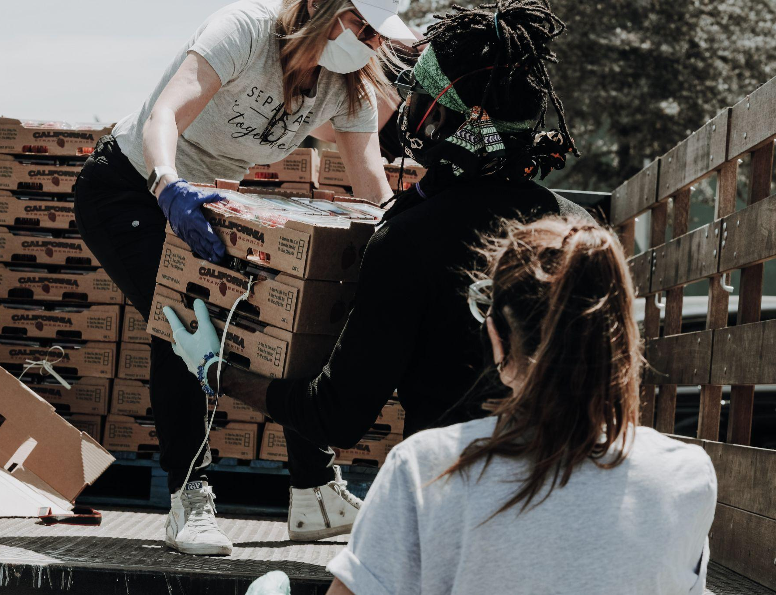
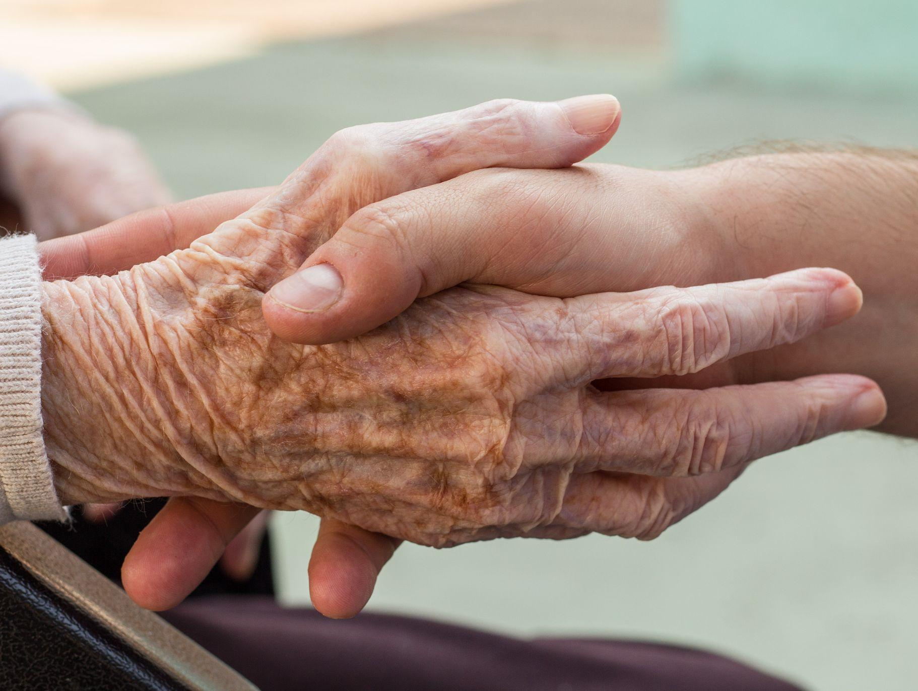
“The purpose of the Synod, and therefore of this consultation, is not to produce documents, but “to plant dreams, draw forth prophecies and visions, allow hope to be nourished, inspire trust, bind up wounds, weave together relationships, awaken a dawn of hope, learn from one another, and create a bright resourcefulness that will enlighten minds, warm hearts, give strength to our hands.”
(PD, 32)

Slide 17
Preparatory Document
Vademecum
Introduction
Principles of a Synodal Process
The Process of the Synod
Travelling the Synodal Path in Dioceses
Resources for organizing the Synodal Process
+ Appendices, materials, and tools (biblical, liturgical, methodological, and practical resources, etc.)
The Call to Journey Together
A Constitutively Synodal Church
Listening to the Scriptures
Jesus, the Crowd, the Apostles
A Double Dynamic of Conversion: Peter and Cornelius (Acts 10)
Synodality in Action: Pathways for Consulting the People of God

Slide 18
The Objectives of the Synod (PD, 2)
recalling how the Spirit has guided the Church’s journey through history and, today, calls us to be, together, witnesses of God’s love;
living a participative and inclusive ecclesial process that offers everyone—especially those who for various reasons find themselves on the margins—the opportunity to express themselves and to be heard in order to contribute to the edification of the People of God;
recognizing and appreciating the wealth and the variety of the gifts and charisms that the Spirit liberally bestows for the good of the community and the benefit of the entire human family;
exploring participatory ways of exercising responsibility in the proclamation of the Gospel and in the effort to build a more beautiful and habitable world

Slide 19
The Objectives of the Synod (PD, 2)
examining how responsibility and power are lived in the Church as well as the structures by which they are managed, bringing to light and trying to convert prejudices and distorted practices that are not rooted in the Gospel
accrediting the Christian community as a credible subject and reliable partner in paths of social dialogue, healing, reconciliation, inclusion and participation, the reconstruction of democracy, the promotion of fraternity and social friendship
regenerating relationships among members of Christian communities as well as between communities and other social groups, e.g., communities of believers of other denominations and religions, civil society organizations, popular movements, etc
fostering the appreciation and appropriation of the fruits of recent synodal experiences on the universal, regional, national, and local levels

Slide 20
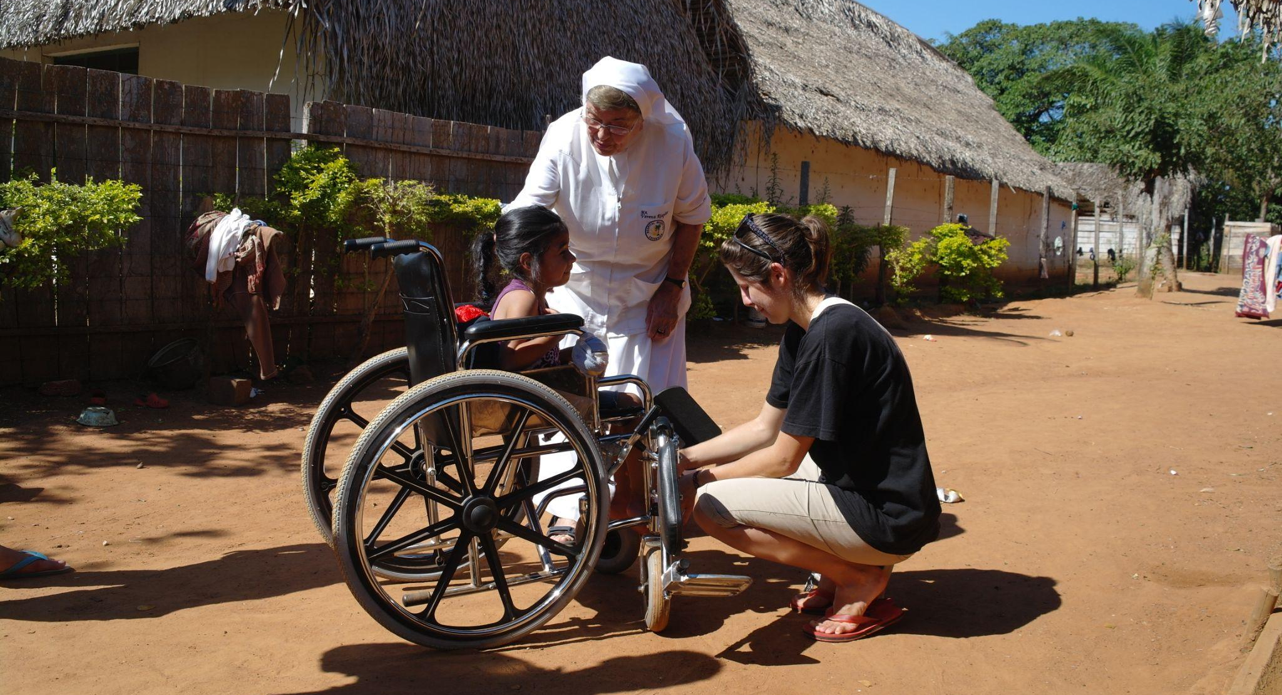
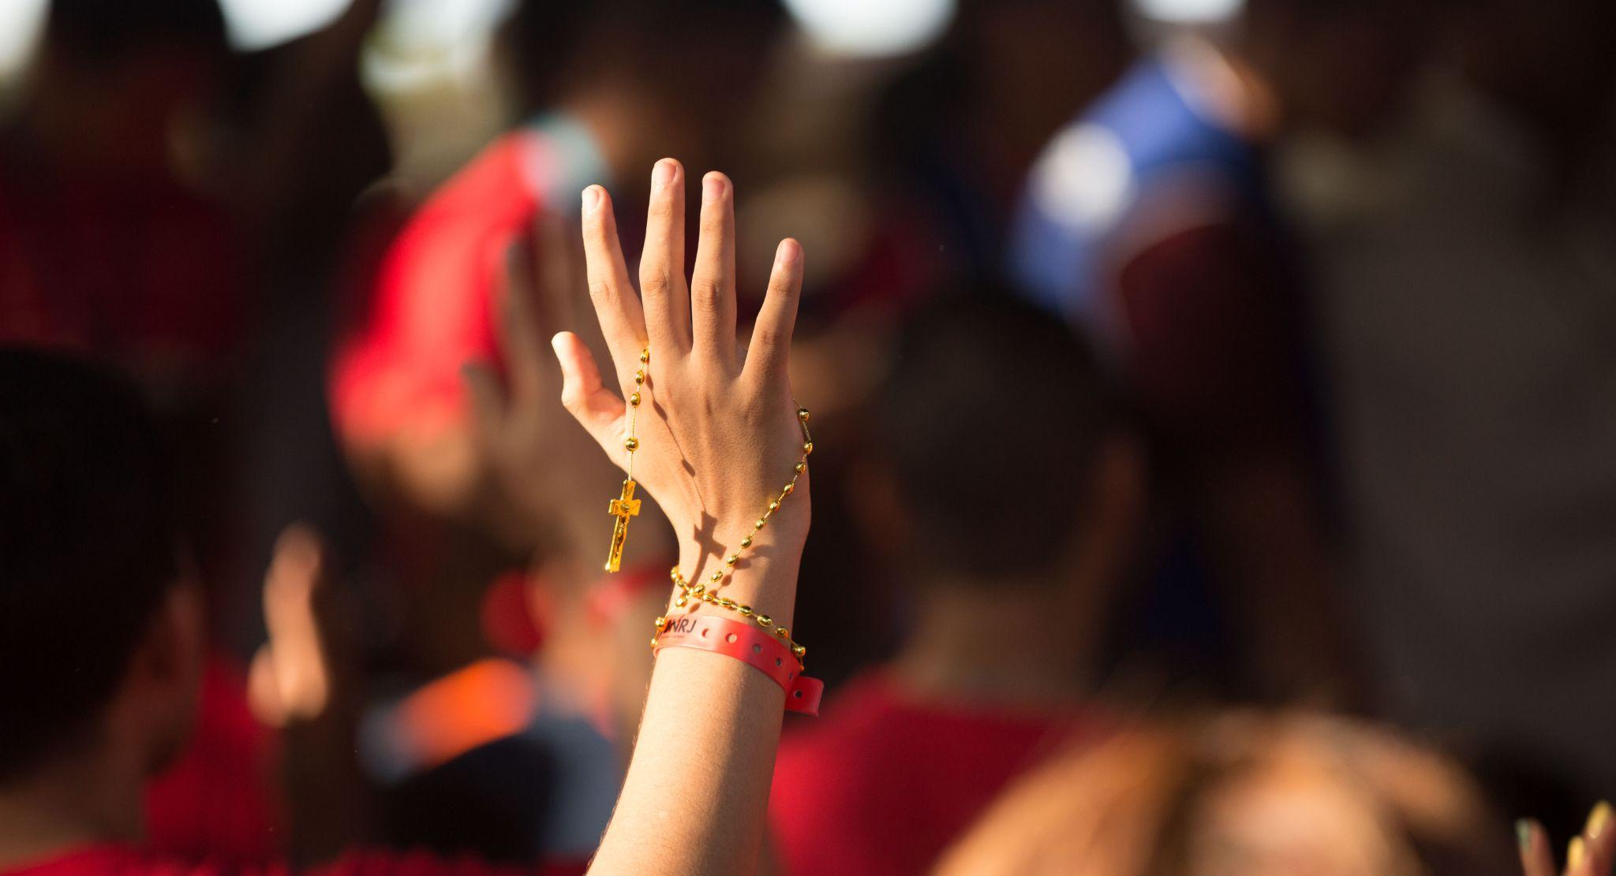
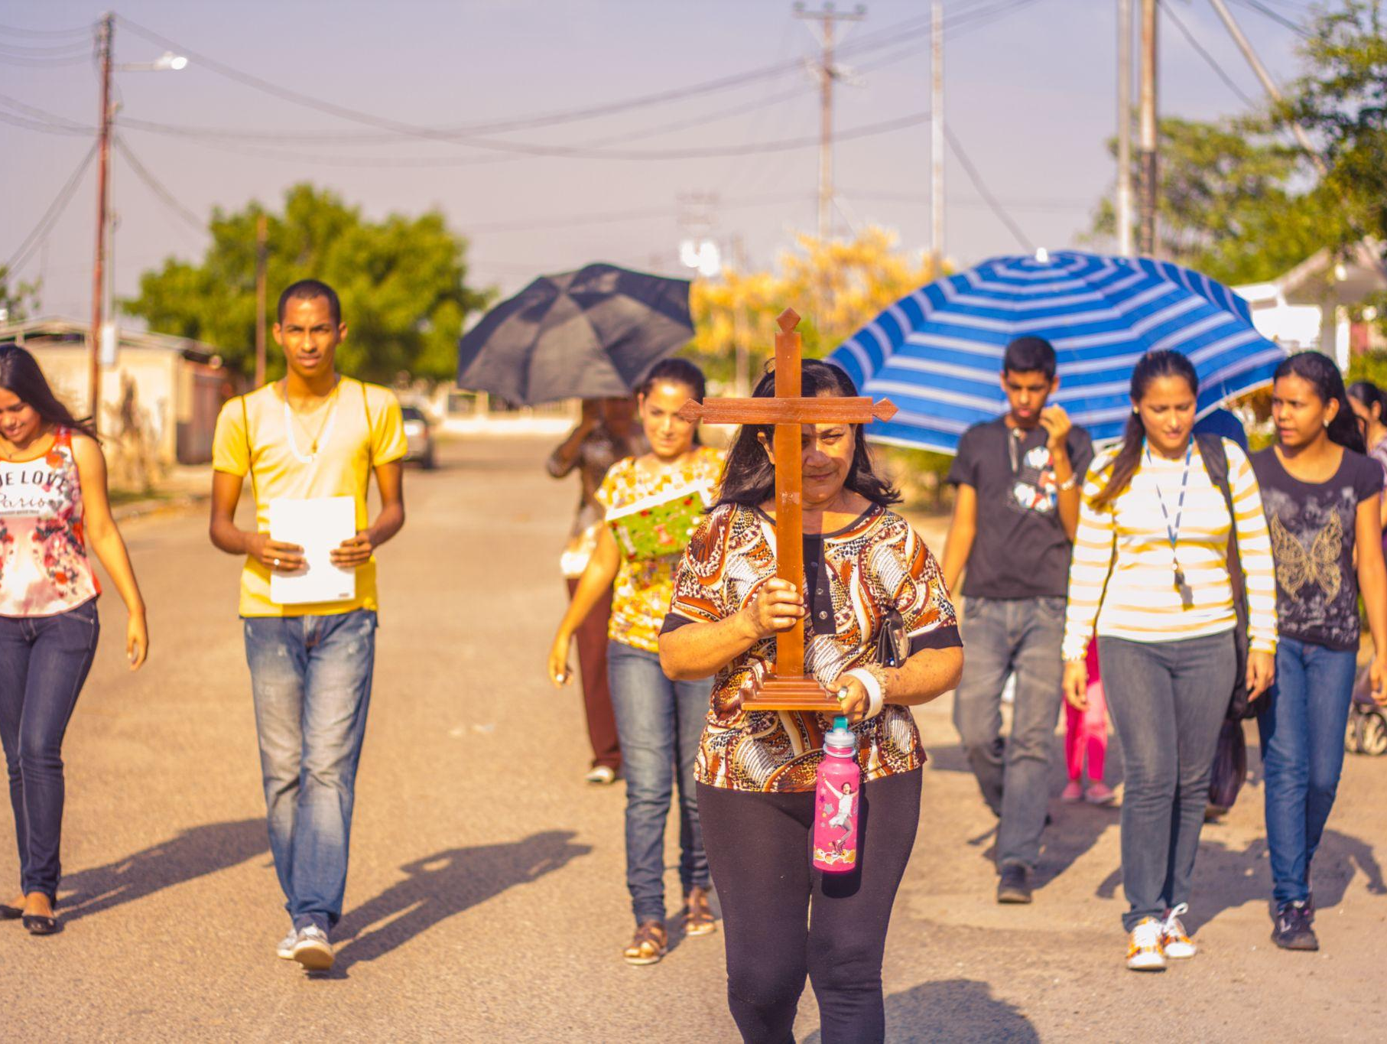
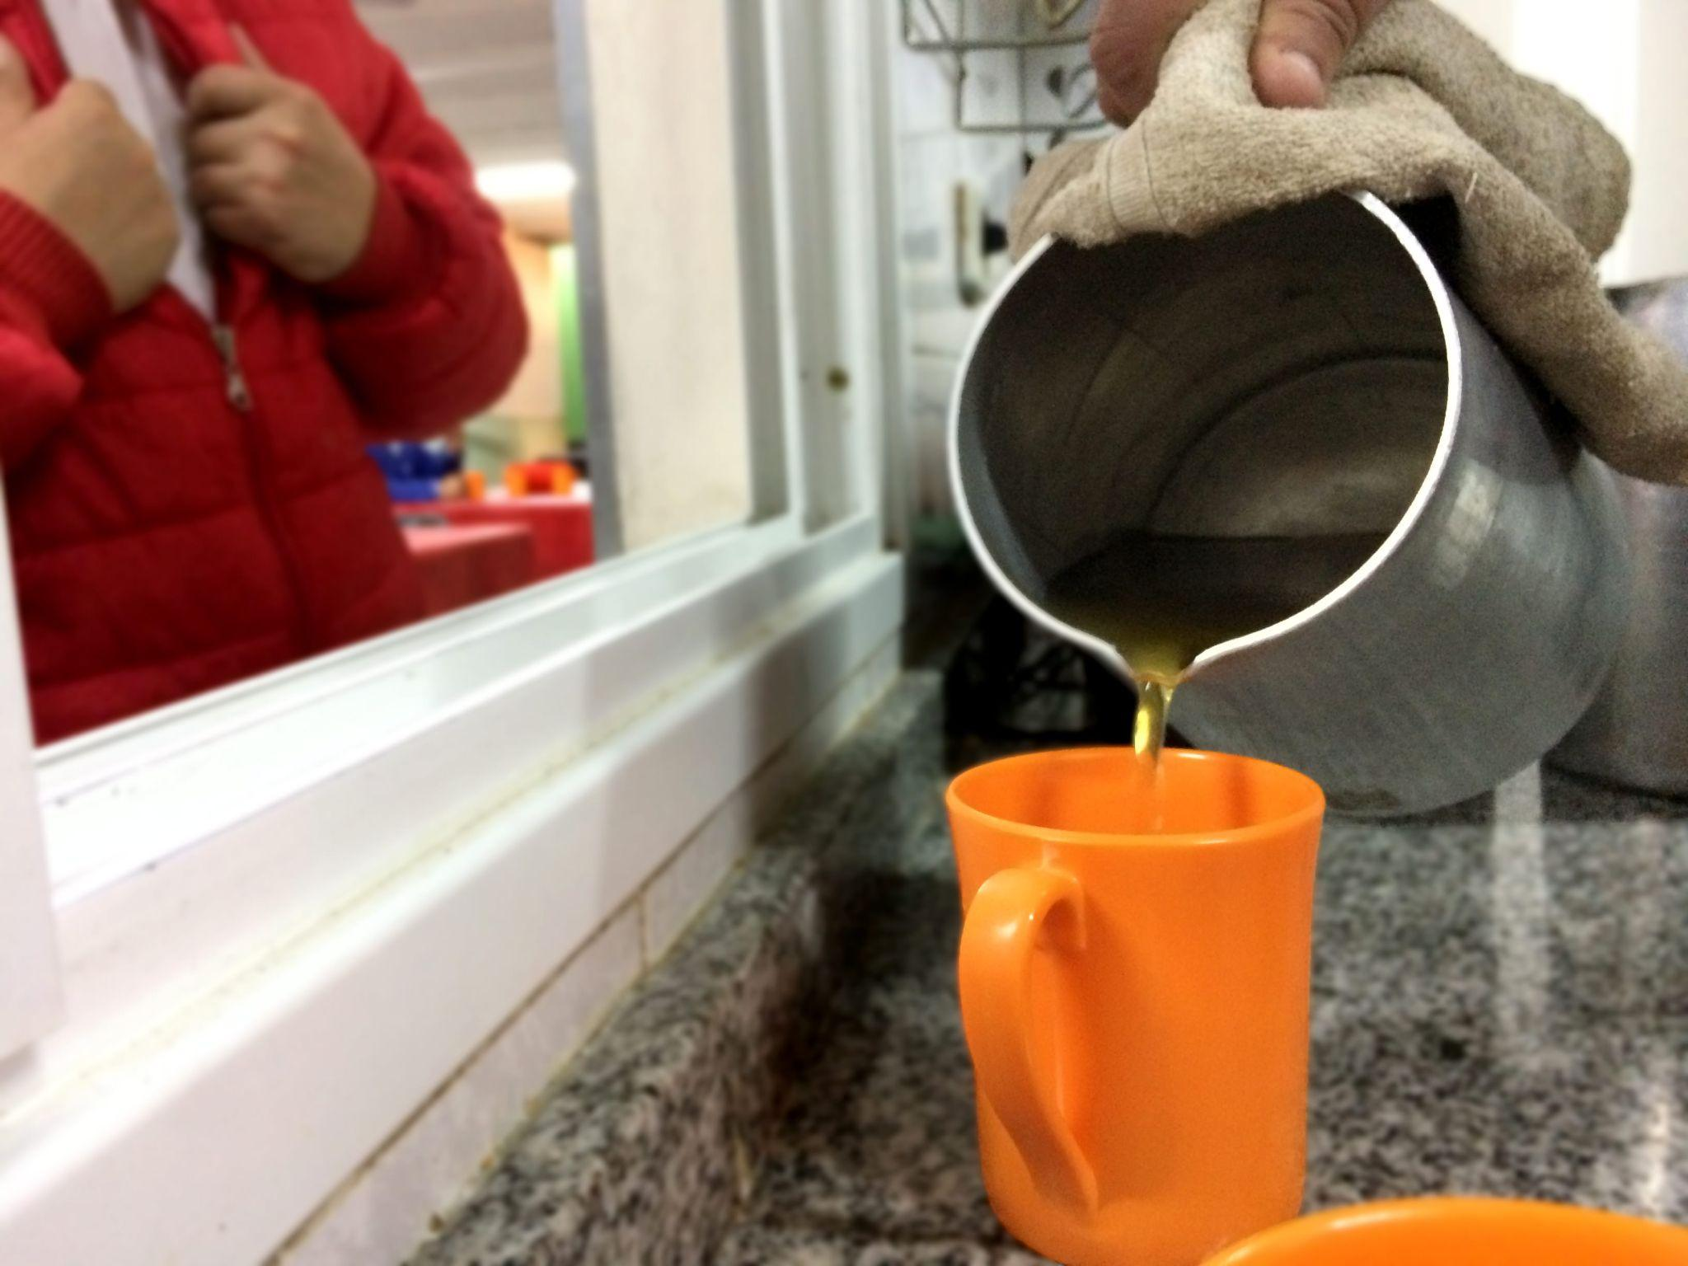
Key convictions for a Synodal Church
Listen to one another in order to listen to the Holy Spirit
In a spirit of prayer, grounded in the liturgy and the Word of God
An experience shared with one another, not just filling out a questionnaire
A process, not a one-time event
Discerning together so that the decisions made are for the good of all

Slide 21
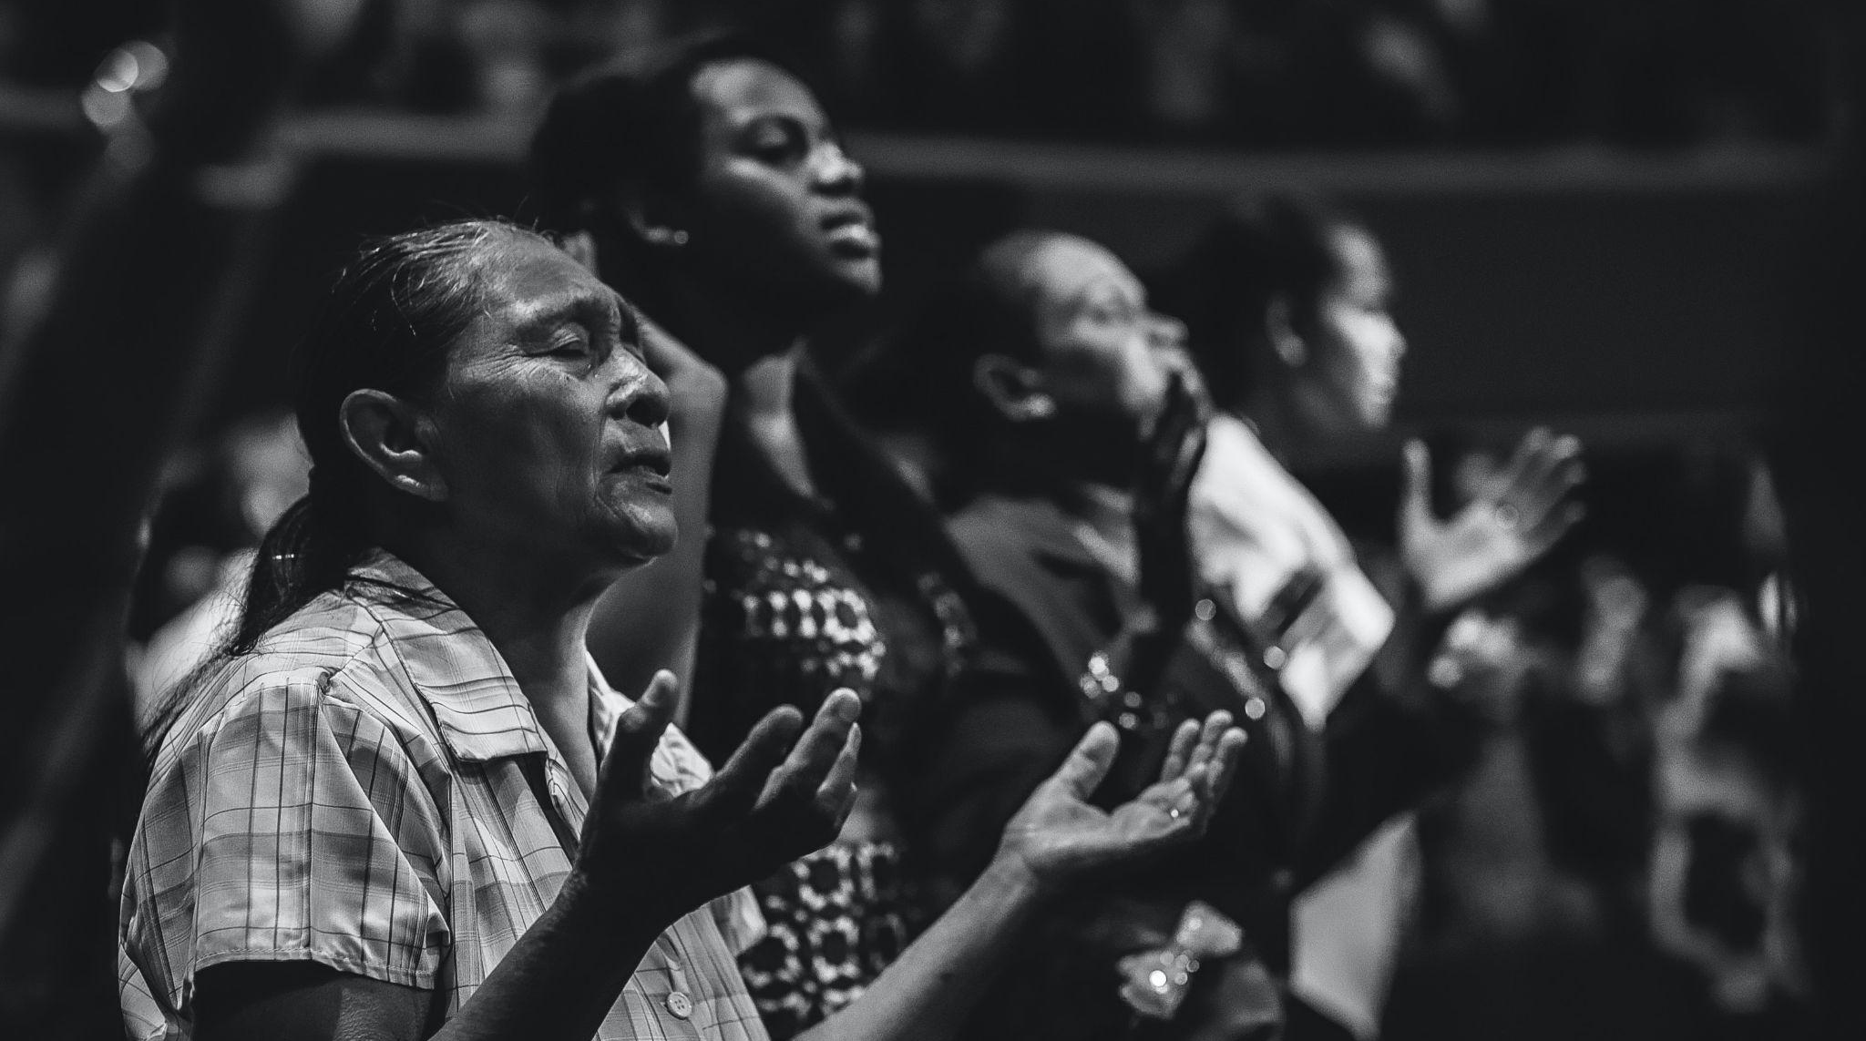

Slide 22
Discerning the signs of the times in the light of the Gospel
“The synodal journey unfolds within a historical context marked by epochal changes in society and by a crucial transition in the life of the Church, which cannot be ignored: it is within the folds of the complexity of this context, in its tensions and contradictions, that we are called to ‘scrutinize the signs of the times and interpret them in the light of the Gospel’ (GS, 4).”
(PD, 4)
The global tragedy of the COVID-19 pandemic
Inequalities and injustices: massification, fragmentation, the conditions faced by migrants, divisions across the family of humanity
The cry of the poor and the cry of the earth
We are all in the same boat…We are one human family living in our common home.
(Laudato Si’ and Fratelli Tutti)

Slide 23
“Within this context, synodality represents the main road for the Church,called to renew herself under the action of the Spirit and by listening to the Word.” (PD, 9)
Imagining a different future for the Church
Being a prophetic witness to the human family, which needs to be united around a common goal

Slide 24
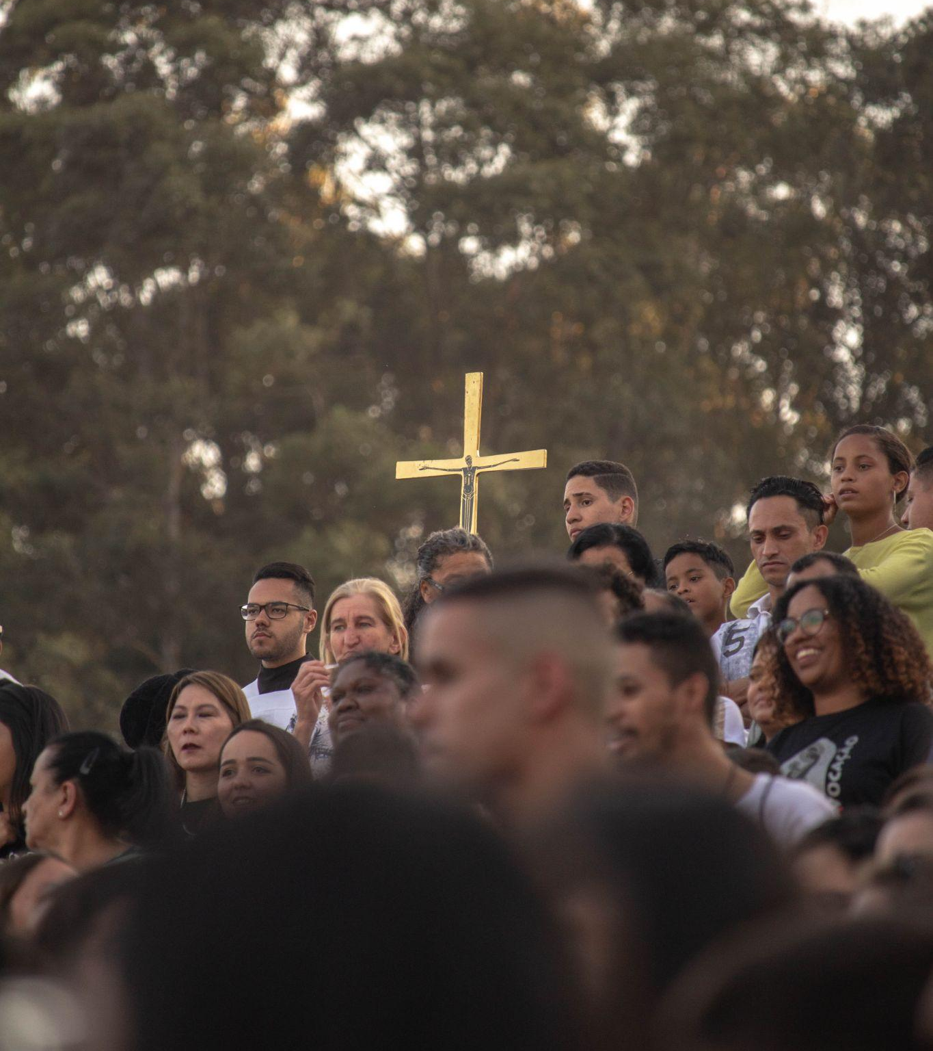
Listening to the Scriptures
Jesus, the Crowd, and the Apostles
“The work of evangelization and the message of salvation would not be comprehensible without Jesus’ constant openness to the widest possible audience, which the Gospels refer to as the crowd, that is, all the people who follow him along the path, and at times even pursue him in the hope of a sign and a word of salvation: this is the second actor on the scene of Revelation. The proclamation of the Gospel is not addressed only to an enlightened or chosen few.” (PD, 18)
🡪 In order for the Church to be herself, and for her mission to bear fruit, all three must always be present: Jesus, the crowd, and the apostles!

Slide 25
Listening to the Scriptures
A Double Dynamic of Conversion:
Peter and Cornelius (Acts 10)
“It is in the encounter with people, welcoming them, journeying with them, and entering their homes, that he realizes the meaning of his vision: no human being is unworthy in the eyes of God, and the difference established by election does not imply exclusive preference but service and witnessing of a universal breadth.” (PD, 23)

Slide 26
Synodality in action: pathways for consulting the People of God (PD, 26)
In order to respond, you are invited to:
a) ask yourselves what experiences in your particular Church the fundamental question calls to mind;
b) reread these experiences of “journeying together” in greater depth: What joys did they provoke? What difficulties and obstacles have they encountered? What wounds have they brought to light? What insights have they elicited?
c) gather the fruits to share: Where, in these experiences, does the voice of the Spirit resound? What is he asking of us? What are the points to be confirmed, the prospects for change, the steps to be taken? Where do we register a consensus? What paths are opening up for our particular Church?
Notes:
http://www.vatican.va/content/francesco/en/apost_constitutions/documents/papa-francesco_costituzione-ap_20180915_episcopalis-communio.html

Slide 27
Basic Question of the Synodal Process
A basic question prompts and guides us: How does this “journeying together,” which takes place today on different levels (from the local level to the universal one), allow the Church to proclaim the Gospel in accordance with the mission entrusted to her; and what steps does the Spirit invite us to take in order to grow as a synodal Church?
(PD, 2)
The fundamental question for the consultation of the People of God
A synodal Church, in announcing the Gospel, “journeys together:” How is this “journeying together” happening today in your local Church? What steps does the Spirit invite us to take in order to grow in our “journeying together”?
(PD, 26)

Slide 28
Ten Themes to Explore
DIALOGUE IN CHURCH AND SOCIETY: Dialogue is a path of perseverance that also includes silences and sufferings, but which is capable of gathering the experience of persons and peoples.
ECUMENISM: The dialogue between Christians of different confessions, united by one baptism, has a special place in the synodal journey.
AUTHORITY AND PARTICIPATION: A synodal Church is a participatory and co-responsible Church.
DISCERNING AND DECIDING: In a synodal style, decisions are made through discernment, based on a consensus that flows from the common obedience to the Spirit.
FORMING OURSELVES IN SYNODALITY: The spirituality of journeying together is called to become an educational principle for the formation of the human person and of the Christian, of the families, and of the communities.
COMPANIONS ON THE JOURNEY: In the Church and in society, we are side by side on the same road.
LISTENING: Listening is the first step, but it requires having an open mind and heart, without prejudice.
SPEAKING OUT: All are invited to speak with courage and parrhesia, that is, integrating freedom, truth, and charity.
CELEBRATION: “Journeying together” is only possible if it is based on communal listening to the Word and the celebration of the Eucharist.
SHARING RESPONSIBILITY FOR OUR COMMON MISSION: Synodality is at the service of the mission of the Church, in which all members are called to participate.

Slide 29
Reinvigorating Collegial Bodies
Episcopalis Communio, 7. “In the Church the purpose of any collegial body, whether consultative or deliberative, is always the search for truth or the good of the Church. When it is therefore a question involving the faith itself, the consensus ecclesiae is not determined by the tallying of votes, but is the outcome of the working of the Spirit, the soul of the one Church of Christ.”
Giving New Life to Synodal Institutions
The Synod of Bishops and Diocesan Synods
Pastoral Councils, on the Diocesan and Parish levels, and the Presbyteral Council
A Local, Provincial, or General Chapter for Religious Communities
General Assemblies and Councils of Movements in the Church
Notes:
http://www.vatican.va/content/francesco/en/apost_constitutions/documents/papa-francesco_costituzione-ap_20180915_episcopalis-communio.html

Slide 30
A key objective of the Vademecum: promoting adaptation to the local context
The Vademecum handbook is offered as a guide to support each local Church’s efforts, not as a rulebook. Those who are responsible for organizing the process of listening and dialogue at the local level are encouraged to be sensitive to their own culture and context, resources, and constraints, and to discern how to implement this diocesan synodal phase, guided by their diocesan Bishop. We encourage you to take useful ideas from this guide, but also to have your own local circumstances as your starting point. New and creative pathways may be found for working together among parishes and dioceses in order to bring this Synodal Process to fruition. This Synodal Process need not be seen as an overwhelming burden that competes with local pastoral care. Rather, it is an opportunity to foster the synodal and pastoral conversion of each local Church so as to be more fruitful in mission.

Slide 31
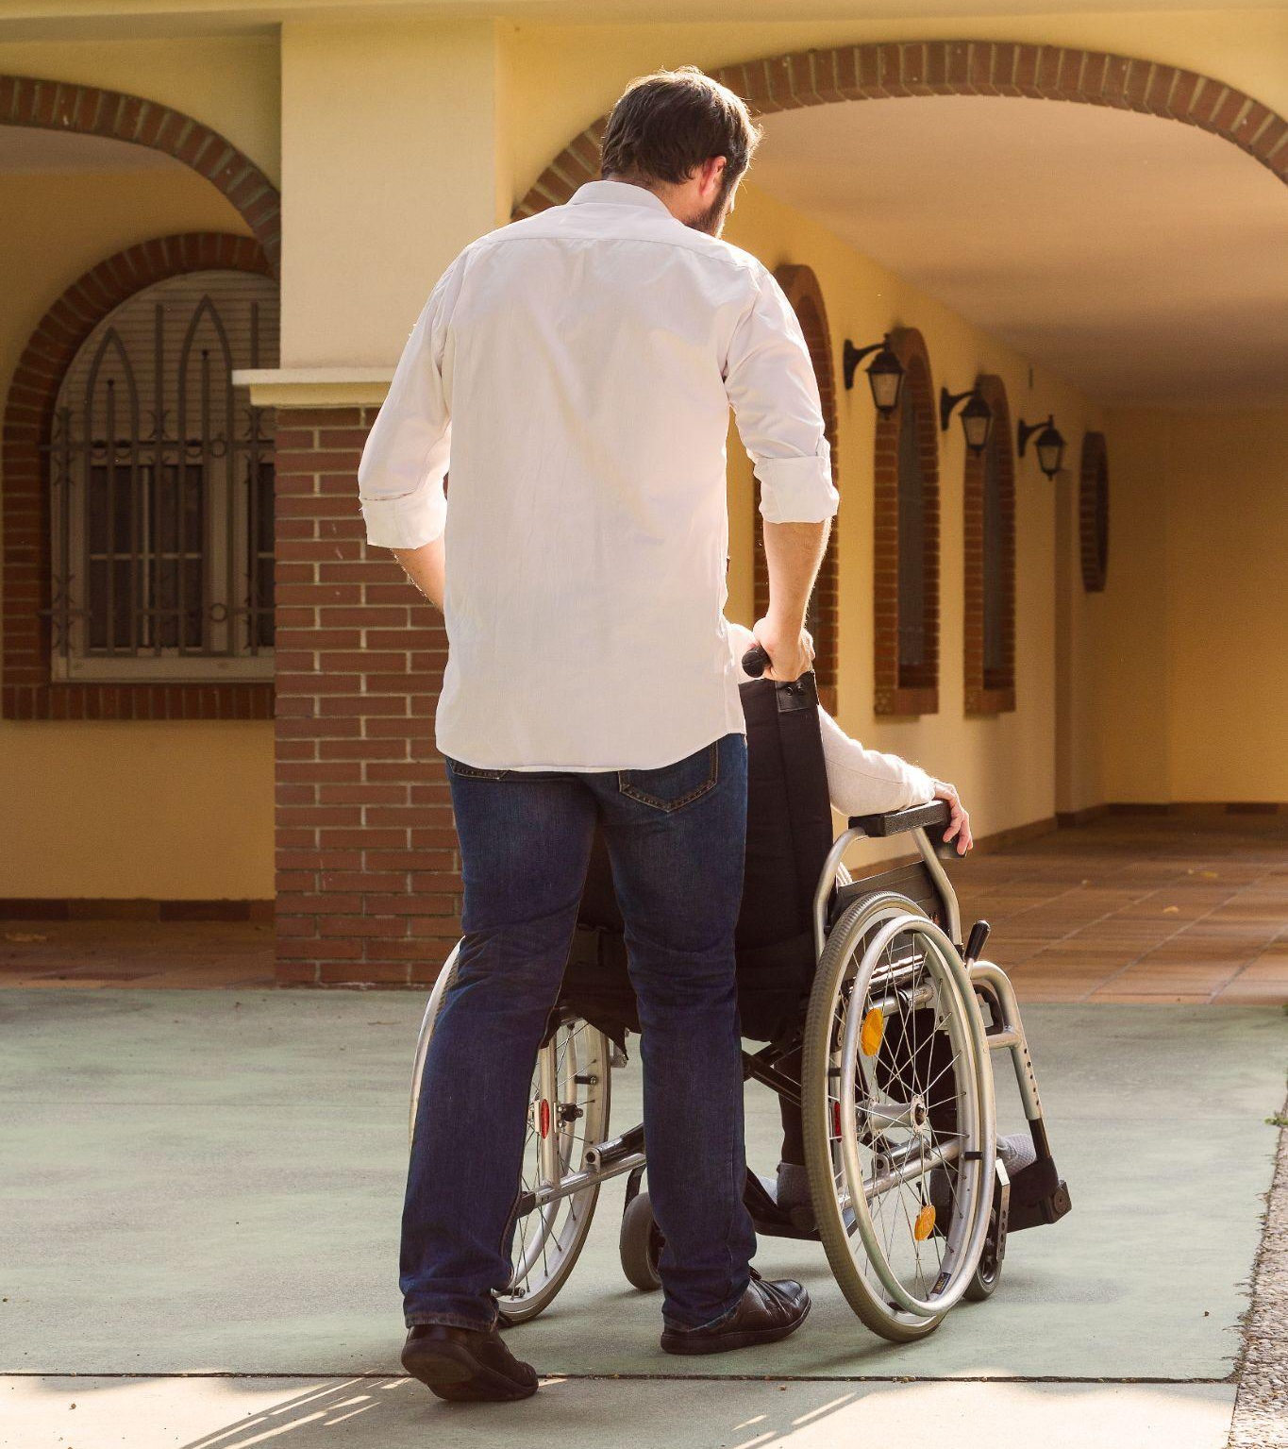
FOSTERING WIDE PARTICIPATION IN THE SYNODAL PROCESS
The goal is to ensure the participation of the greatest number possible, in order to listen to the living voice of the entire People of God.
This is not possible unless we make special efforts to actively reach out to people where they’re at, especially those who are often excluded or who are not involved in the life of the Church.
There must be a clear focus on the participation of the poor, marginalized, vulnerable, and excluded, in order to listen to their voices and experiences.
The Synodal Process must be simple, accessible, and welcoming for all.

Slide 32
CREATING A SYNODAL EXPERIENCE AND GATHERING THE FRUITS
The Vademecum aims to promote the practice of synodality on the local level: the goal is not simply to provide responses to pre-determined questions, but to open a space for sharing a synodal experience with one another at the local level.
To foster a synodal experience, the Vademecum proposes diverse methodologies and tools that can be adapted locally.
The diocesan synthesis should collect the fruits and honest feedback of participants from the local synodal experience, rather than transmitting generic summaries.

Slide 33
The Diocesan Phase of the Synod
Dates: From 7 October 221 to 30 April 2022
Objectives: Consultation of the People of God: to listen, participate, discern
How the consultation should be carried out:
Honestly: the People of God are truly consulted
As broadly as possible: everyone participates, including those on the margins
Practical: provides concrete help for the mission to evangelize
Aids for the Diocesan Phase:
Synodal Team coordinating this consultation in each Diocese
Diocesan Assembly at the end of the consultation for comunal discernment

Slide 34
Unfolding of the Diocesan Phase
Those Responsible:
The People of God, called to participate
The Diocesan Bishop, responsible for the discernment process
The Synodal Team, coordinates and animates
Pastors, responsible for enabling the participation from the parish level
Materials:
The 10 “Thematic Nuclei” from the Preparatory Document
Anything that the Diocese is able to prepare
To Keep in Mind:
This is not about responding to a questionnaire or random list of questions
All materials must foster dialogue and discernment

Slide 36
Thank you!

